Slide 1
Statistical Measures
Measures of Central Tendency, Variation, Skewness and Correlation

Slide 2
Contents
01
02
Measure of Central Tendency
Measure of Variation
Understanding mean, median, and mode as measures that identify the center of your data distribution
Exploring how spread-out the data is using range, IQR, and standard deviation
03
04
Measure of Skewness
Bivariate Analysis
Analyzing the symmetry of data distributions and understanding what skewness reveals
Examining relationships between two variables through correlation and scatter plots

Slide 3
Measures of Central Tendency
A single value that describes a set of data by identifying the central position as a summary measure.
Three Key Measures
Mean
Median
Mode
Sum of all values divided by total number of values. Most commonly used measure
of central tendency.
Middle value when data is arranged in ascending order. Represents the 50th percentile of your dataset.
Most frequently occurring observation in the data set. Can be useful for categorical data analysis.

Slide 4
Understanding Through Example
Consider a company with 1,000 employees. Let's see how each measure of central tendency tells us something different about the age distribution of the workforce.
Mean
Median
Mode
Average age of all employees working in the company
Age below and above which half of the employees fall
Age of the maximum number of employees
This gives you the overall average, but can be influenced by very young interns or older executives.
This tells you the typical employee age, unaffected by extreme values on either end.
This reveals the most common age group in the organization.

Slide 5

Measures of Central Tendency: A Practical Example
Let's work through a concrete example using student test scores to see how each measure is calculated.
Student marks: 13, 20, 16, 17, 09, 18, 17, 11, 08, 17, 12, 20
14.83
16.5
17
Mean
Median
Mode
Average marks scored
Half scored above/below
Most common score
Sum of all values divided by the
number of students
Middle value when arranged in order
Appears three times in the dataset
Notice how the three measures give us different perspectives on the same data. The mode is highest, the median falls in between, and the mean is pulled down slightly by the lower scores.

Slide 6
Trimmed Mean: Handling Outliers
When your data contains extreme values that don't represent the typical pattern, a trimmed mean provides a more robust measure of central tendency.
Purpose
Benefit
Excludes extreme data points, typically removing 5% of observations at each end of the sorted dataset. This helps eliminate the distorting effect of outliers.
Provides a robust estimate if the underlying distribution is symmetric. Best practice: report both trimmed mean and regular mean when outliers are present.
For example, if you're analyzing housing prices and a few mansions skew your data, a trimmed mean would exclude these extreme values and better represent typical home prices.

Slide 7
Choosing the Right Measure
Not all measures of central tendency are appropriate for all types of data. The variable type determines which measure provides the most meaningful summary.
Nominal
Ordinal
Best Measure: Mode
Best Measure: Median
Categories with no order (e.g., colors, brands). Only the most frequent category makes sense.
Ranked categories (e.g., satisfaction ratings). The middle rank is most appropriate.
Interval/Ratio (Symmetric)
Interval/Ratio (Not Symmetric)
Best Measure: Mean
Best Measure: Median
Numeric data evenly distributed. The arithmetic average is ideal.
Skewed numeric data. The median resists outlier influence.

Slide 8
Measures of Variation
Central tendency tells us where the center of our data is, but variation measures tell us how spread out the data points are from that center. Understanding variation is crucial for interpreting data accurately.
Three Key Measures
1
2
3
Range
Inter-Quartile Range (IQR)
Standard Deviation (SD)
Difference between the highest and lowest values in your dataset. Simple to calculate but sensitive to extreme values.
Range between lower quartile (Q1) and upper quartile (Q3). Captures the spread of the middle 50% of data, resistant to outliers.
Based on sum of squares of deviations from mean. The positive square root of variance. Measures average distance from the mean.

Slide 9
Coefficient of Variation
Comparing Variability Across Different Scales
The Coefficient of Variation (CV) is a relative measure of variation used to compare variability between two or more datasets, especially when they have different units or vastly different means.
CV is defined as "Standard Deviation divided by Mean" and is generally expressed as a percentage.
Unit-free comparison between different data sets
Higher CV indicates more variability
Also known as Relative Standard Deviation
Allows you to compare the variability of measurements in different units, like comparing consistency in kilograms versus pounds.
A larger coefficient means the data is more spread out relative to its mean, indicating less consistency or stability.
Commonly used in quality control, finance, and any field requiring precision comparisons across different scales.

Slide 10



Real-World Applications: Central Tendency
Understanding when to use each measure of central tendency helps you communicate data insights more effectively
in practical scenarios.
Mode
Median
Mean
Popular products, most ordered dishes
Median income, house prices
Average class scores, batting averages
Retail stores use mode to identify best-selling items. Restaurants track which dishes are ordered most frequently.
Economic data often uses median because it's robust to extremes.
Educational assessments and sports statistics rely on means to evaluate overall performance across all observations.

Slide 11




Real-World Applications: Variation
Measures of variation reveal consistency, risk, and reliability in your data. Different fields use different variation measures depending on their specific needs.
Standard Deviation
Coefficient of Variation
Risk and volatility in investments
Stability in production quality
Financial analysts use SD to quantify investment risk. Higher SD means more unpredictable returns.
Manufacturing uses CV to compare consistency across different product lines or production processes.
IQR
Range
Spread of middle 50%
Overall spread
Less sensitive to outliers, making it ideal for analyzing typical performance while ignoring extreme cases.
Weather reports use range to show temperature extremes. Simple but informative for understanding total spread.

Slide 12
Comparing Consistency: A Cricket Example
Let's compare two batsmen with identical averages but very different consistency levels. This demonstrates why variation measures matter as much as central tendency.
Batsman A
Batsman B
Scores: 78, 62, 73, 54, 76, 77
Scores: 92, 8, 78, 34, 109, 99
Average: 70
Average: 70
CV: 13.97%
CV: 57.32%
More consistent (lower variability)
Less consistent (higher variability)
Batsman A delivers predictable performance. Selectors can rely on consistent contributions around 70 runs.
Batsman B is unpredictable. Capable of high scores but also single-digit scores.
Despite identical averages, the coefficient of variation reveals dramatically different performance patterns. This insight is crucial for team selection and strategy.

Slide 13
Understanding Skewness
Skewness measures the lack of symmetry in data distribution.
Positively Skewed
Symmetric
Negatively Skewed
Right tail longer
Normal distribution
Left tail longer
Mean > Median > Mode
Mean = Median = Mode
Mode > Median > Mean
Most values cluster on the left with a long right tail. Example: Income distribution where few high earners pull the mean upward.
Perfectly balanced distribution. The bell curve where data spreads evenly around the center.
Most values cluster on the right with a long left tail. Example: Test scores when most students perform well.
Interpretation guideline: Skewness > 1 or < -1 indicates substantial skewness. Normal Distribution is perfectly symmetric with skewness = 0.

Slide 14
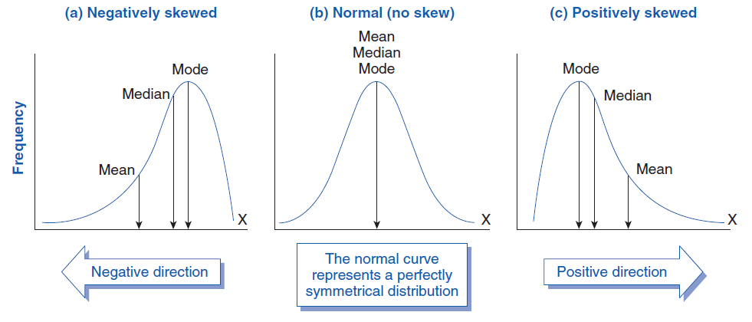
Understanding Skewness

Slide 15
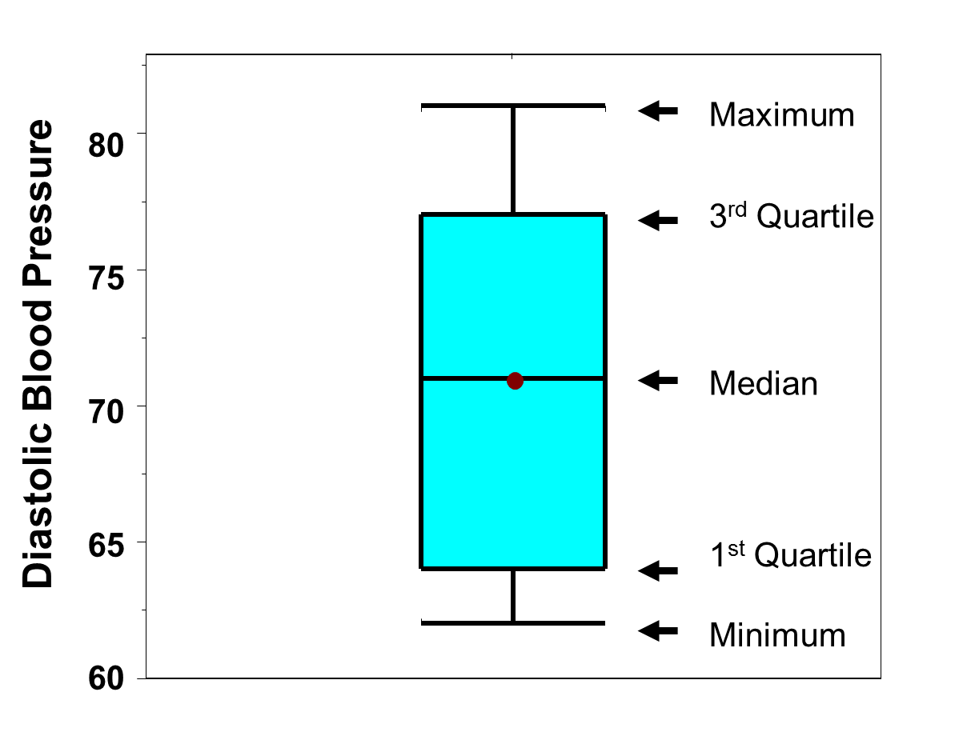
Box-Whisker Plot
Box and Whisker plot summarizes data graphically using 5 measures: Minimum,Q1,Q2,Q3 and Maximum.
The body of the box goes from the first quartile (Q1) to the third quartile (Q3).
The whiskers go from Q1 to smallest no-n outlier and Q3 to highest non-outlier data points.
The distribution is considered symmetric if median is at the center of the box and whiskers have same length

Slide 16
Bivariate Analysis
Bivariate analysis examines the relationship between two variables. The analytical approach depends on whether your variables are categorical or numeric.
1
2
3
Two Categorical Variables
Two Numeric Variables
One Numeric & One Categorical
Techniques: Cross-tabulation, chi-square tests
Techniques: Scatter plots, correlation, regression
Techniques: Group comparisons, ANOVA
Used for analyzing relationships like gender vs. product preference, or education level vs. voting behavior. Creates contingency tables to reveal patterns.
Explores relationships like hours studied vs. exam scores, or temperature vs. ice cream sales. Quantifies strength and direction of relationships.
Compares numeric outcomes across categories, such as salary differences between departments or test scores across teaching methods.

Slide 17
Scatter Plot Analysis
Scatter plots provide a visual representation of the relationship between two numeric variables using the X-axis, Y-axis, and data points. Each point represents one observation.
Positive Correlation
Negative Correlation
No Correlation
Upward trending pattern
Downward trending pattern
Random scattered pattern
As one variable increases, the other tends to increase as well. Points cluster along an upward-sloping line. Example: Study hours and test scores.
As one variable increases, the other tends to decrease. Points cluster along a downward-sloping line. Example: Exercise frequency and body weight.
No clear relationship exists between the variables. Points appear randomly distributed with no discernible pattern.

Slide 18
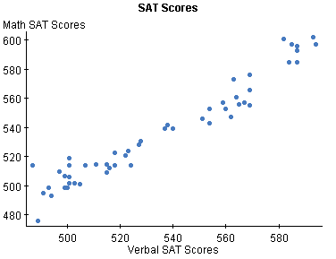
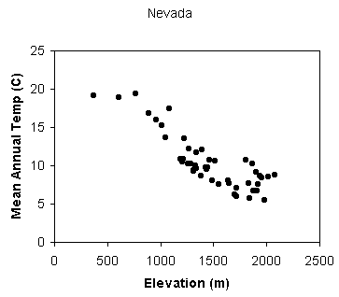
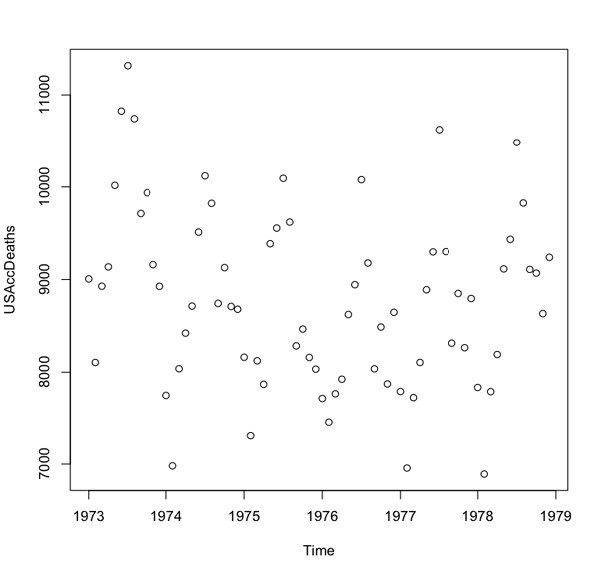
Scatter Plot Analysis
Shows relationship between two numeric variables using X-axis, Y-axis, and data points.
Positive Correlation
Negative Correlation
No Correlation
Upward trending pattern
Downward trending pattern
Random scattered pattern

Slide 19
Pearson's Correlation Coefficient
Pearson's correlation coefficient (r) quantifies the strength and direction of the linear relationship between two
continuous variables.
r = Cov(X,Y) / (σx × σy)
Range: -1 ≤ r ≤ +1
Interpreting the Value
Key Properties
r > 0: Positive correlation (both variables move in the same direction)
Works for continuous numeric variables with linear relationships
Units don't matter—dimensionless measure
r < 0: Negative correlation (variables move in opposite directions)
Not affected by scale changes or transformations
Values closer to -1 or +1 indicate stronger relationships
r = 0: No linear correlation (no relationship detected)
Remember: Correlation does not imply causation. A strong correlation simply means variables move together, not that
one causes the other.

Slide 20
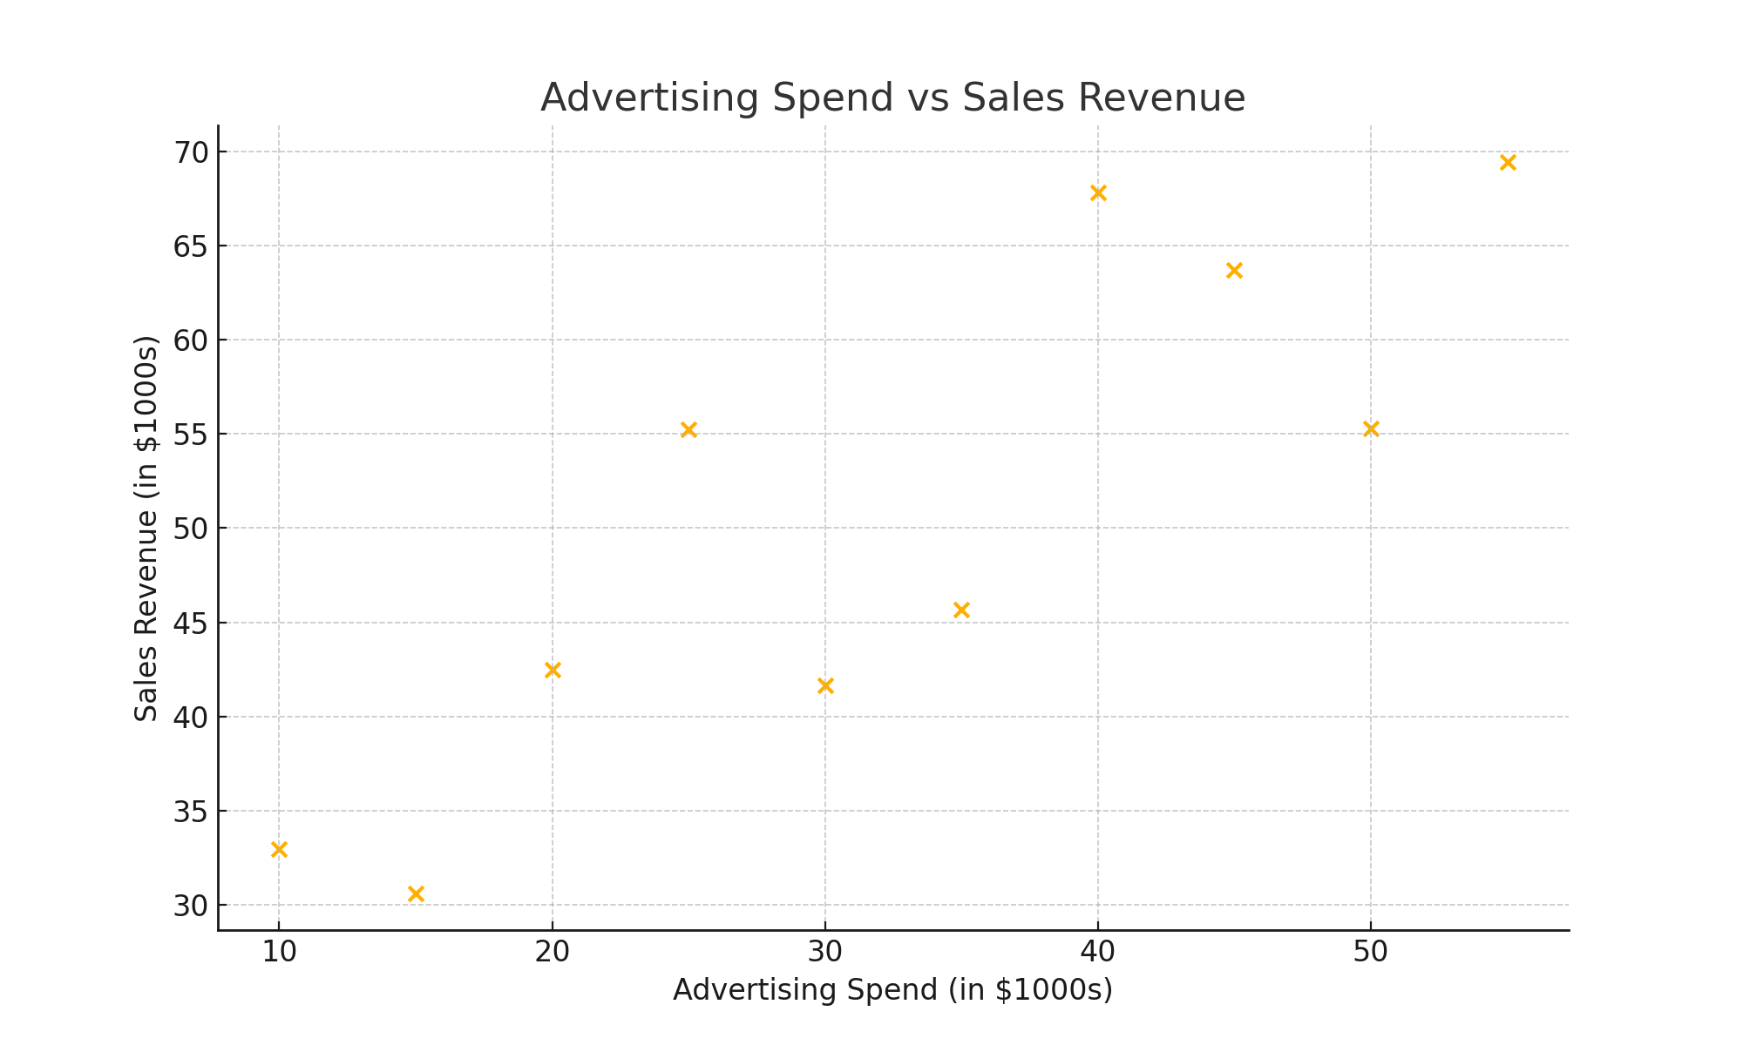
Example: Scatter Plot and Correlation Coefficient
Let X: Advertise Spend and Y: Sales Revenue ( both in $1000s) for 10 stores
X = [ 10.0, 15.0, 20.0, 25.0, 30.0, 35.0, 40.0, 45.0, 50.0, 55.0 ]
Y = [ 33.0, 30.6, 42.5, 55.2, 41.7, 45.7, 67.8, 63.7, 55.3, 69.4 ]
Correlation Coefficient=0.85
High Positive Correlation

Slide 21




Key Takeaways
Measures of Central Tendency
Measures of Variation
Mean, Median and Mode
Decide appropriate measure
Gives spread of the data , understanding sources of variation is the key concept in statistics
Measure of Skewness
Bivariate Analysis
Scatter plot is for visualizing relationship and correlation
coefficient quantifies degree of correlation
Skewness measures lack of symmetry

